Slide 1
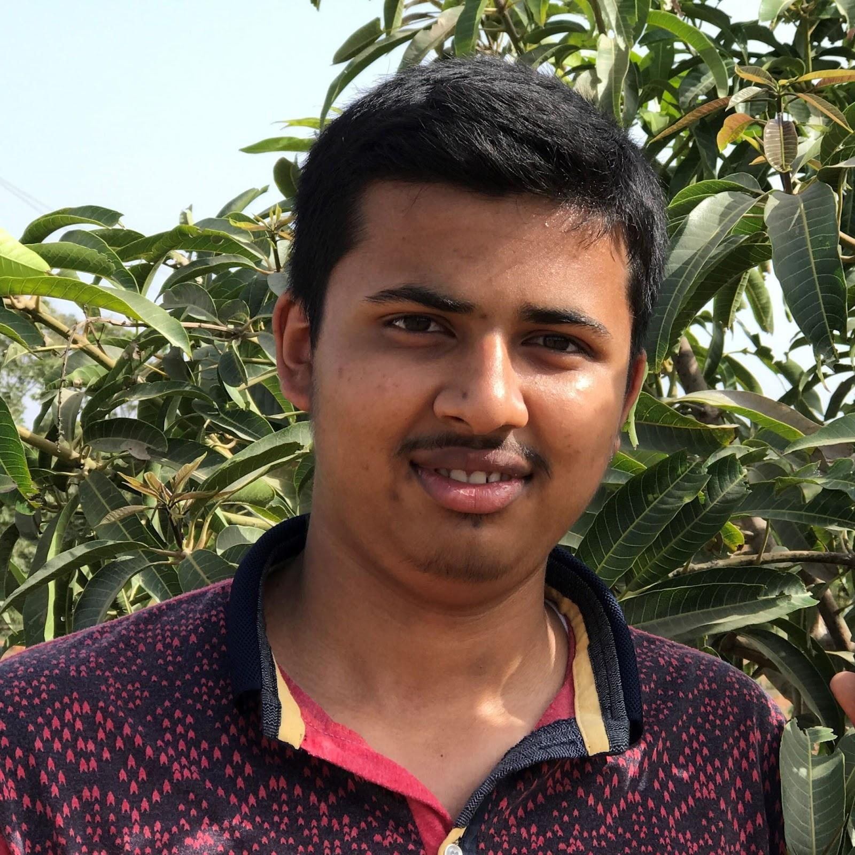
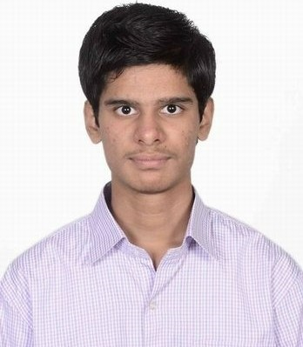

Developing State-Of-The-Art Massively Multilingual Machine Translation Systems for Related Languages
Jay Gala
AI4Bharat
IIT Madras, India
Pranjal A. Chitale
AI4Bharat, IIT Madras, India
Raj Dabre
NICT
Kyoto, Japan

Slide 2
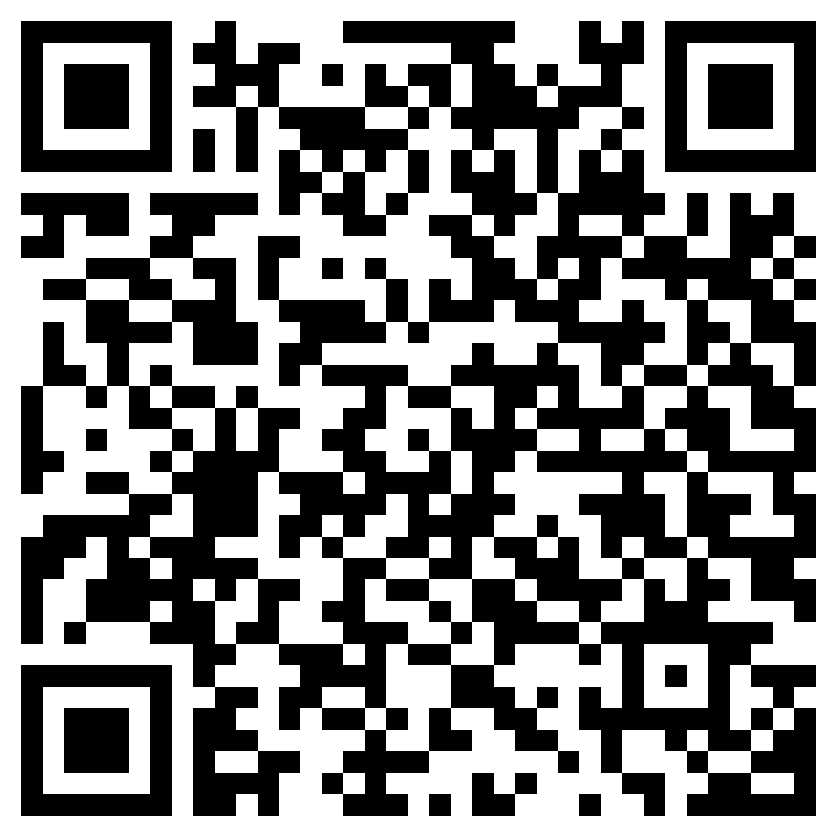
Get access to the slides here
https://github.com/AI4Bharat/aacl23-mnmt-tutorial
(under construction)

Slide 3
Self Introduction: Jay Gala (jaygala24.github.io)
Experience
2022 - present: AI Resident, AI4Bharat (IIT Madras)
2021 - 2022: Research Intern, UCSD
Research
Multilingual NLP
Translation, Language Modeling: 2022 - present
Efficient Deep Learning
Data Pruning: 2022 - present
Neural Architecture Search: 2021 - 2022
Federated Learning: 2021 - 2022

Slide 4
Self Introduction: Pranjal A. Chitale (cs21s022@cse.iitm.ac.in)
Experience
2021-present: MS Student at IIT Madras (AI4Bharat)
2017-2021: BE Computer Engineering, University of Mumbai
Research
Multilingual NLP
Translation, Language Modeling.
Efficient Deep Learning

Slide 5
Self Introduction: Raj Dabre (prajdabre@gmail.com)
Experience
2018-present: Researcher at NICT, Japan
Visiting researcher at AI4Bharat, IIT Madras (and perhaps more soon 🤫)
2014-2018: MEXT Ph.D. scholar at Kyoto University, Japan
2011-2014: M.Tech. Government RA at IIT Bombay, India
Research
Low-Resource Natural Language Processing
Multilingual Machine Translation: 2012-present
Document Level Machine Translation: 2021-
Large Scale Pre-training for Generation: 2021-
Efficient Deep Learning:
Compact, flexible and fast models (2018-present)

Slide 6
Table of Contents
Introduction + Prominent MNMT (35 mins)
Data + Benchmark (40 mins)
Vocabulary (20 mins)
Break & Q/A (15-20 mins)
Architecture + Training (70 mins)
Automatic Evaluation (10 mins)
Human Evaluation (10 mins)
Future work (10 mins)
Q/A

Slide 7
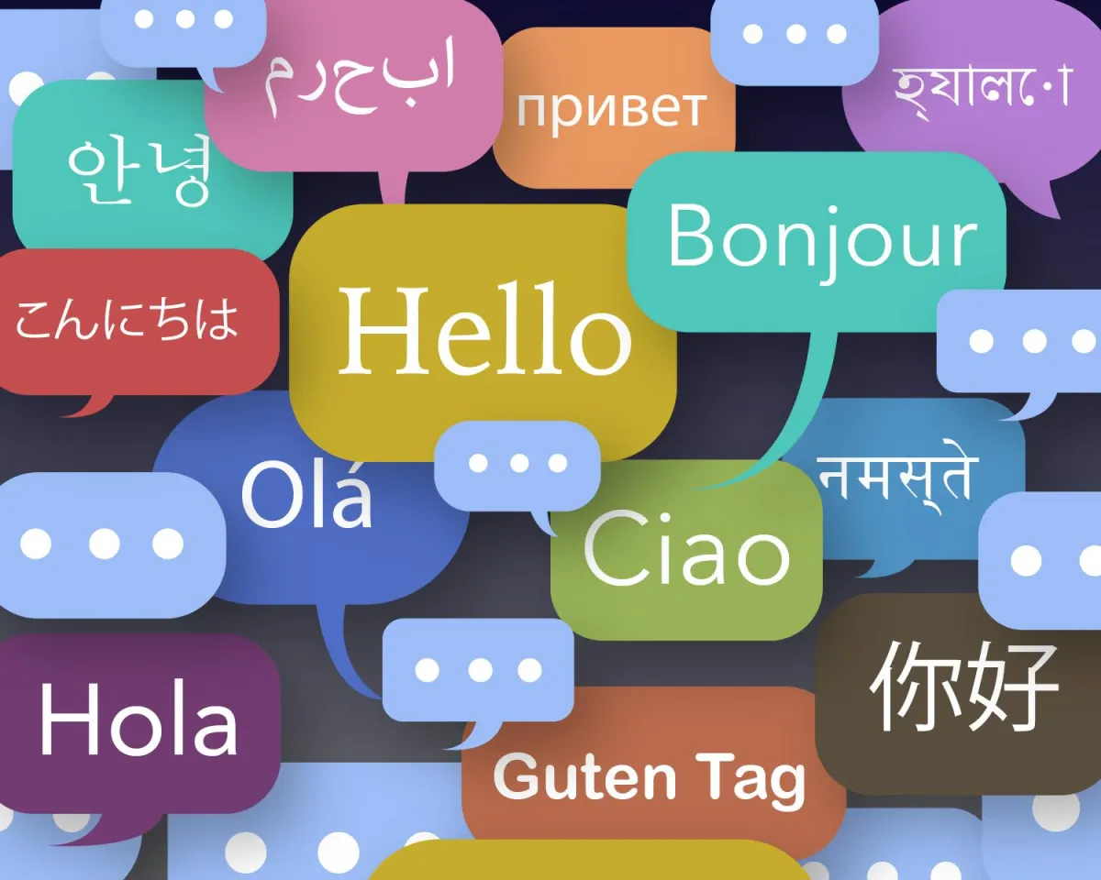
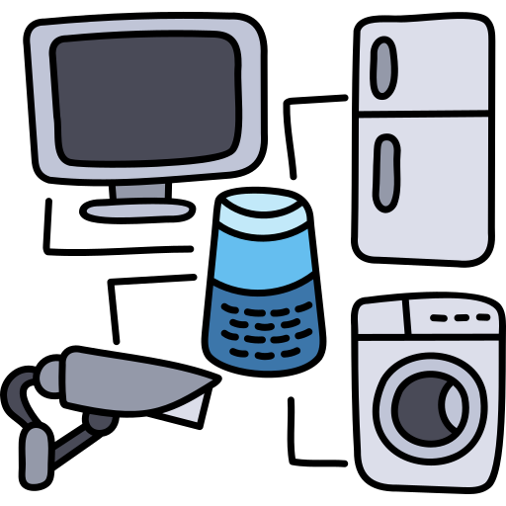
Why Machine Translation is still an important task?
Inclusivity and Accessibility
Data Augmentation for Multilingual Performance Enhancement
Bridge gap between low-resource languages (HRL) and high-resource languages (HRL)
Improve language coverage
(only covers ~1K of ~7K in the world)
Transfer Learning via Translation
Unlocking Multilingual Capabilities of LLMs

Slide 8
Evolution of Machine Translation
Rule-Based
Machine Translation
(RBMT)
Example-Based
Machine Translation
(EBMT)
Statistical Machine Translation
(SMT)
Neural Machine Translation (NMT)
Direct MT
Transfer-based MT
Interlingua MT
Word-based
Syntax-based
Phrase-based
RNNs
LSTMs
Transformers
1950 - 1980
1980 - 1990
1990 - 2015
2015 -

Slide 9
Evolution of Machine Translation
Rule-Based
Machine Translation
(RBMT)
Example-Based
Machine Translation
(EBMT)
Statistical Machine Translation
(SMT)
Neural Machine Translation (NMT)
Direct MT
Transfer-based MT
Interlingua MT
Word-based
Syntax-based
Phrase-based
RNNs
LSTMs
Transformers
1950 - 1980
1980 - 1990
1990 - 2015
2015 -
This Tutorial

Slide 10
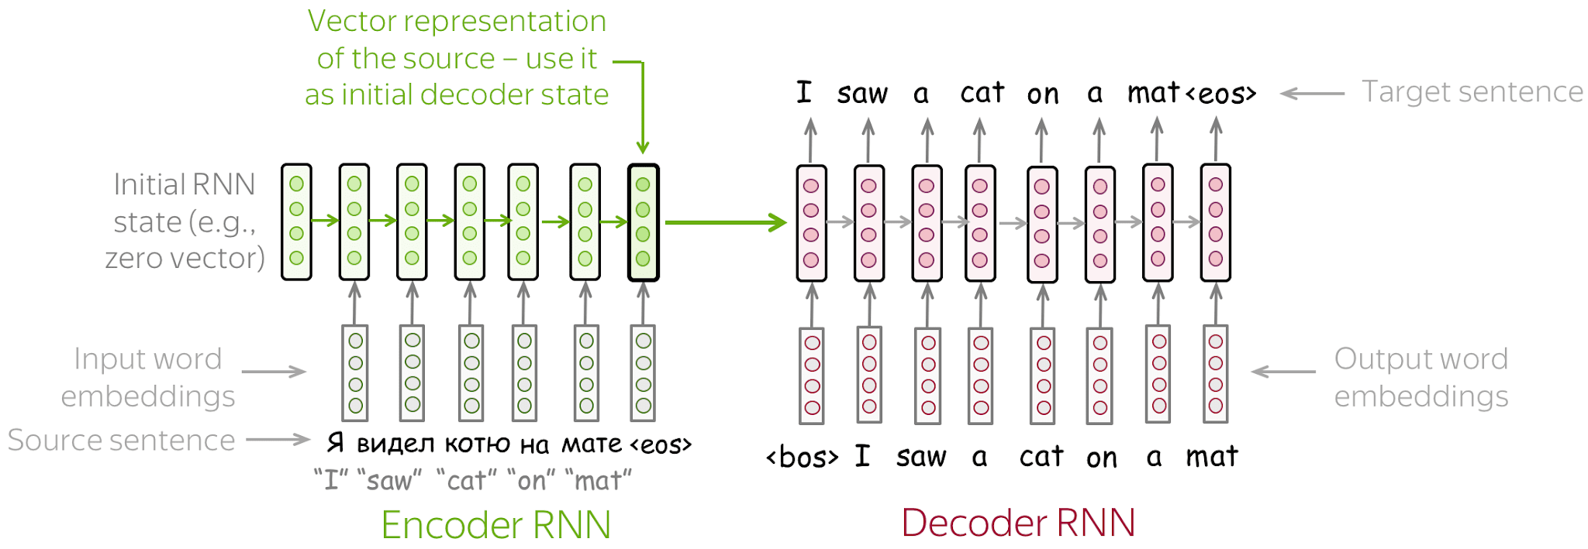
Neural MT Basics: Encoder-Decoder Paradigm
image credits
Sutskever et al. 2014

Slide 11
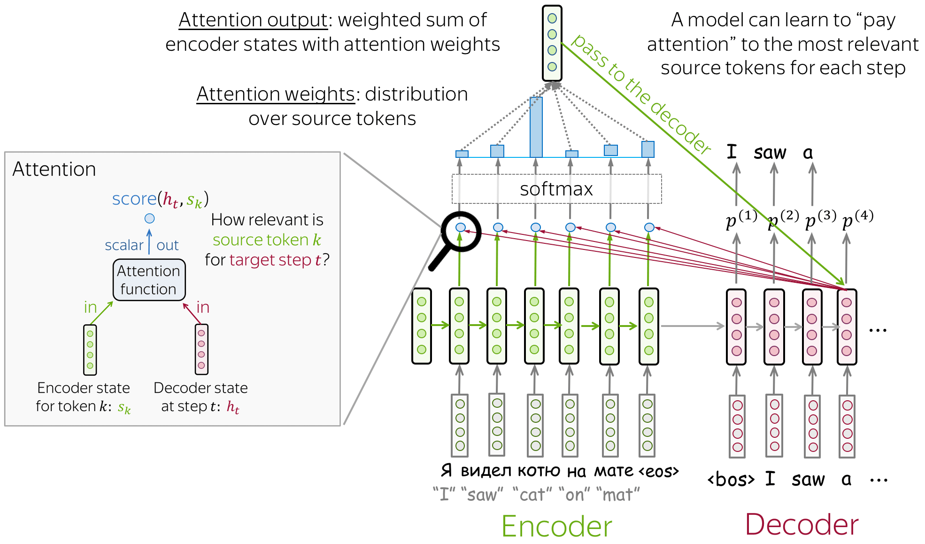
Neural MT Basics: Encoder-Decoder with Attention
image credits
Bahdanau et al. 2015

Slide 12
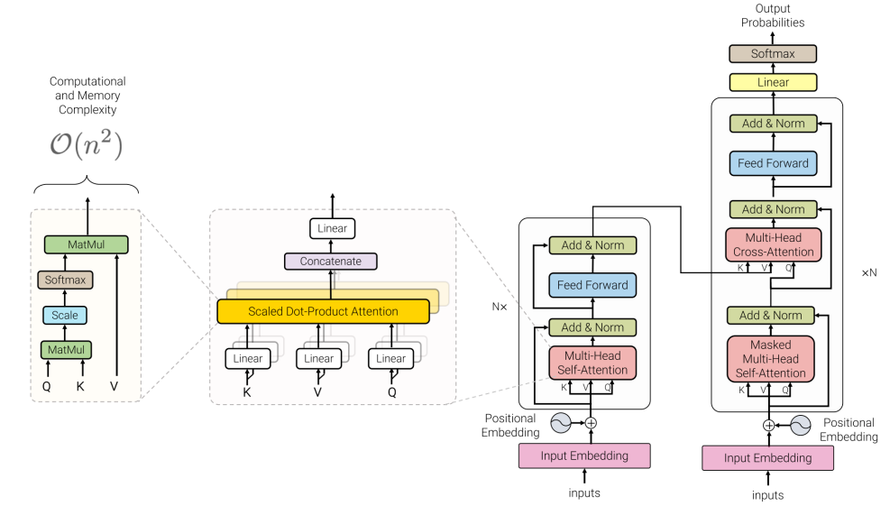
Neural MT Basics: Transformer Architecture
image credits
Vaswani et al. 2017

Slide 13
Neural MT Basics: Tokenization
Word-level tokenization
Split on whitespace.
Drawbacks:
Cannot handle OOV cases.
Large vocabulary with redundant entries.
Character-level tokenization
Split on characters.
No OOV.
Small Vocab-size.
Drawbacks:
Longer token sequences.
Lacks semantic meaning which is present at word-level.
Sub-word level tokenization
Intermediate solution between word-level and character-level.
Very frequent words at word-level.
Rare words represented at character level.
Best of both worlds.

Slide 14
Neural MT Basics: Subword MT
frequency | word
5 | l o w
2 | l o w e r
6 | n e w e s t
3 | w i l d e s t
{l, o, w, e, r, n, w, s, t, i, d}
Senrich et al. 2016

Slide 15
Neural MT Basics: Subword MT - Sennrich et al. 2016
frequency | word | word
5 | l o w | l o w
2 | l o w e r | l o w e r
6 | n e w e s t | n e w es t
3 | w i l d e s t | w i l d es t
{l, o, w, e, r, n, w, s, t, i, d, es}
Senrich et al. 2016

Slide 16
Neural MT Basics: Subword MT - Sennrich et al. 2016
frequency | word | word | word
5 | l o w | l o w | l o w
2 | l o w e r | l o w e r | l o w e r
6 | n e w e s t | n e w es t | n e w est
3 | w i l d e s t | w i l d es t | w i l d est
{l, o, w, e, r, n, w, s, t, i, d, es, est}
Senrich et al. 2016

Slide 17
Neural MT Basics: Subword MT - Sennrich et al. 2016
frequency | word | word | word | word
5 | l o w | l o w | l o w | lo w
2 | l o w e r | l o w e r | l o w e r | lo w e r
6 | n e w e s t | n e w es t | n e w est | n e w est
3 | w i l d e s t | w i l d es t | w i l d est | w i l d est
{l, o, w, e, r, n, w, s, t, i, d, es, est, lo}
Senrich et al. 2016

Slide 18
Neural MT Basics: Subword MT - Sennrich et al. 2016
frequency | word | word | word | word | word
5 | l o w | l o w | l o w | lo w | low
2 | l o w e r | l o w e r | l o w e r | lo w e r | low e r
6 | n e w e s t | n e w es t | n e w est | n e w est | n e w est
3 | w i l d e s t | w i l d es t | w i l d est | w i l d est | w i l d est
{l, o, w, e, r, n, w, s, t, i, d, es, est, lo, low}
Senrich et al. 2016

Slide 19
Neural MT Basics: Advances in Subword-level Tokenization
Byte-level BPE (BBPE)
Inclusion of all unicode characters increases base vocabulary
Use 256 base tokens to overcome the above and ensure coverage with effectively no UNK token.
GPT-2 used BBPE, with 256 base tokens and 50K merges
WordPiece
Outlined in Schuster et al. 2012, popularized by BERT (Delvin et al., 2018).
Initialize character-level vocab similar to BPE.
Now, instead of including most frequent symbol, choose the symbol that maximizes likelihood of training data post adding to the vocabulary.
Unigram (SentencePiece)
Initialize a large vocabulary and trim it based on training data likelihood while minimizing loss increase.
Prune until desired size is reached, retaining base characters.
Store tokenization options with corpus probabilities, defaulting to the most likely choice.
Wang et al. 2019, Delvin et al. 2018, Kudo et al. 2018

Slide 20
Prominent Massively Multilingual NMT systems

Slide 21
Google’s Multilingual NMT
First approach to train a single enc-dec based model for multilingual NMT
Shared vocabulary + Prepend target language token (<2en> / <2es>).
Improves performance on low-resource languages (transfer-learning).
Enables zero-shot translation.
Data and compute efficient compared to bilingual NMT models.
Johnson et al. 2016

Slide 22
Google’s Massively MNMT
59-lingual low-resource models (6-layer transformer base)
One to many models better than many-to-many for non-English targets
2-3 BLEU improvement
Relative over-representation of English
Many to one models worse than many-to-many for English targets
2-3 BLEU drop
Relative under-representation of English
Aharoni et al. 2019

Slide 23
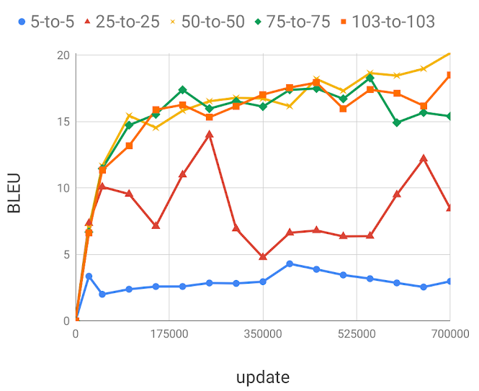
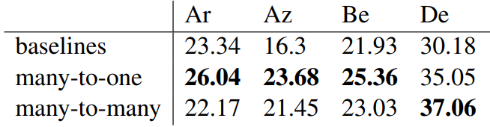
Google’s Massively MNMT
103-lingual model (6-layer variation of transformer-big)
Many-to-one and one-to-many are both better than many-to-many
N-way corpora is detrimental to many-to-one performance
Supervised NMT quality degrades with more languages
Zero-shot NMT quality increases with more languages
Ukranian to Russian Zero-Shot
Aharoni et al. 2019

Slide 24
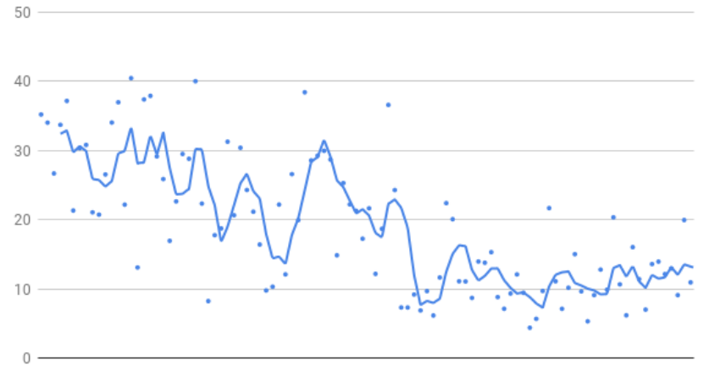
Google’s Massively MNMT Model In the Wild
Main contributions
Temperature based data sampling for transfer-interference balance
Pushing number of supported language pairs to limit
Pushing MNMT performance with 1+ billion parameters
Starting point: Quality is directly proportional to data size
Arivazhagan et al. 2019

Slide 25
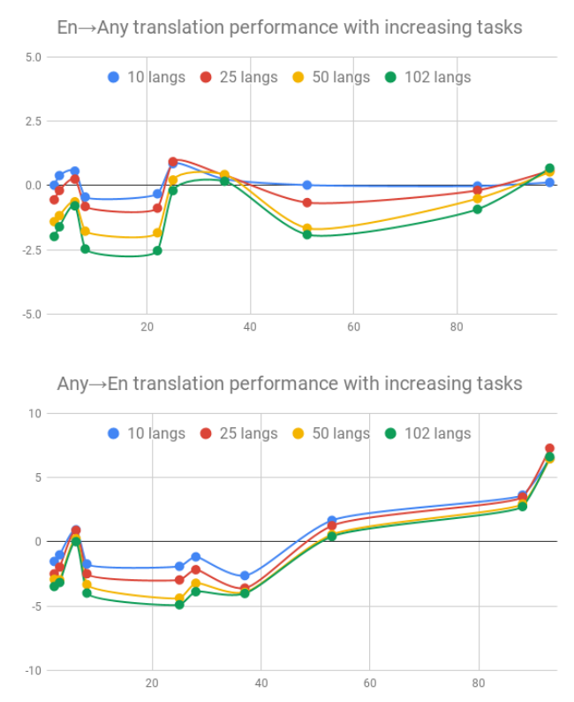
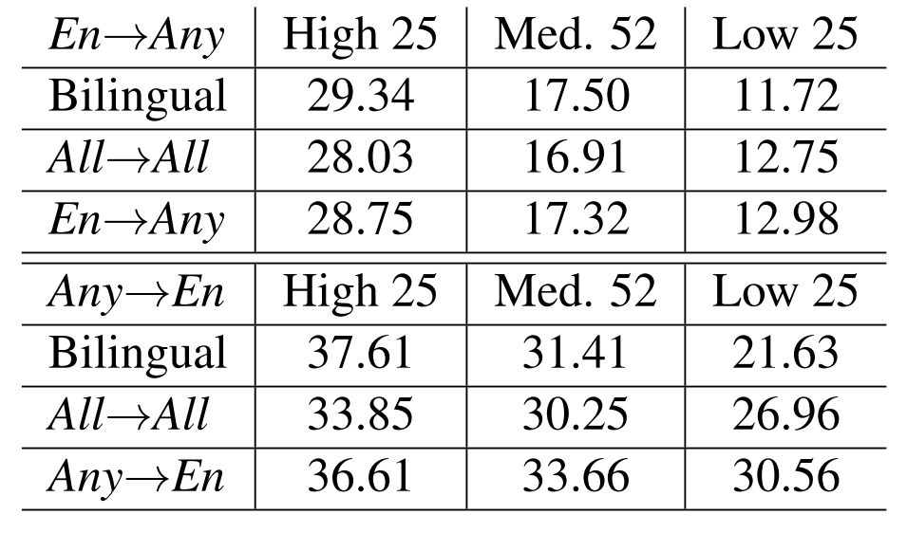
tl;dr
One-to-many and many-to-one models better than many-to-many model
Arivazhagan et al. 2019

Slide 26
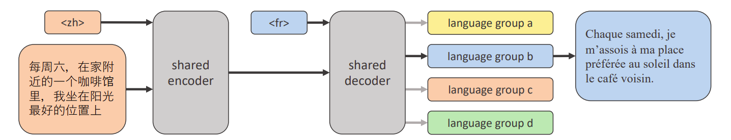
M2M-100: Beyond English-Centric NMT
First MNMT model trained with large-scale non-English centric mined data.
It outperforms English-centric systems by 10 points on the widely used BLEU metric for evaluating machine translations
M2M-100 is trained on a total of 2,200 language directions — or 10x more than previous best, English-centric multilingual models.
LASER2 model used for mining and fastext for language identification.
Fan et al. 2020

Slide 27
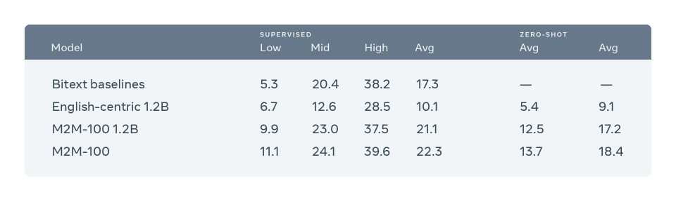
M2M-100 Model : 15B parameter model.
12B dense and ~3B sparse language-specific (family) parameters.
1.2 BLEU point improvement on an average over 1B model (24E-24D).
Fan et al. 2020

Slide 28
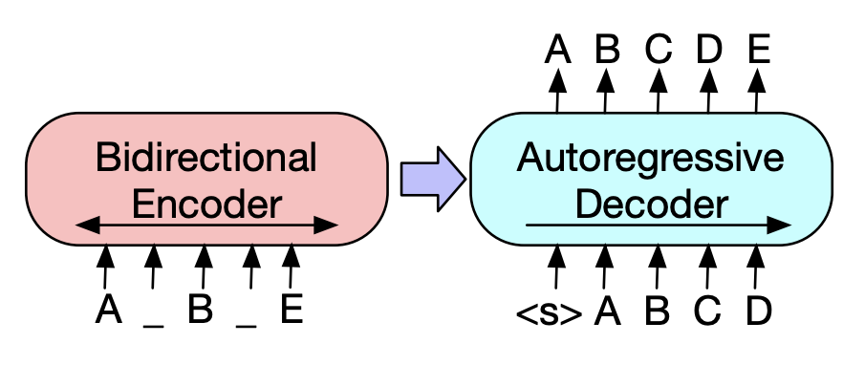
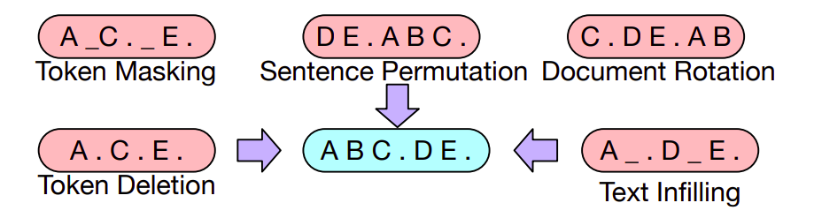
BART
Similar to MLM models such as BERT, RoBERTa, etc for enc-dec LMs
BART: English-pretraining
Fine-tune the models on specific tasks → transfer learning
mBART-25 (Liu et al. 2020) and mBART-50 (Tang et al., 2020) extends the same idea for multilingual models.
Denoising Pretraining
Lewis et al. 2020

Slide 29
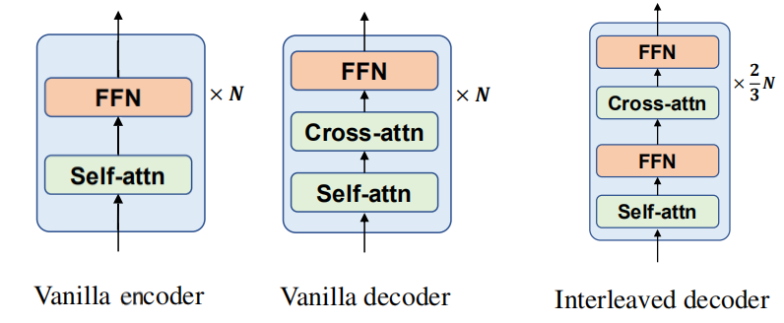
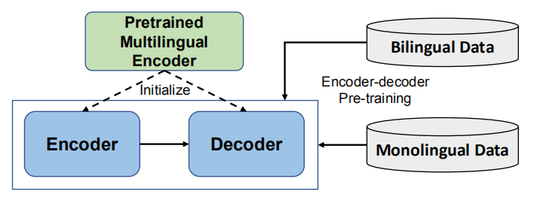
DeltaLM
Interleaved Decoder:
Leverages complete weights of PME, while XLM does random init of CA.
SA and bottom FFNs initialized using odd layers, CA and top FFNs initialized using even.
Initialize Encoder and Decoder with pretrained multilingual encoders (InfoXLM).
Trained with monolingual + bilingual data using MLM + TLM.
Ma et al. 2021

Slide 30
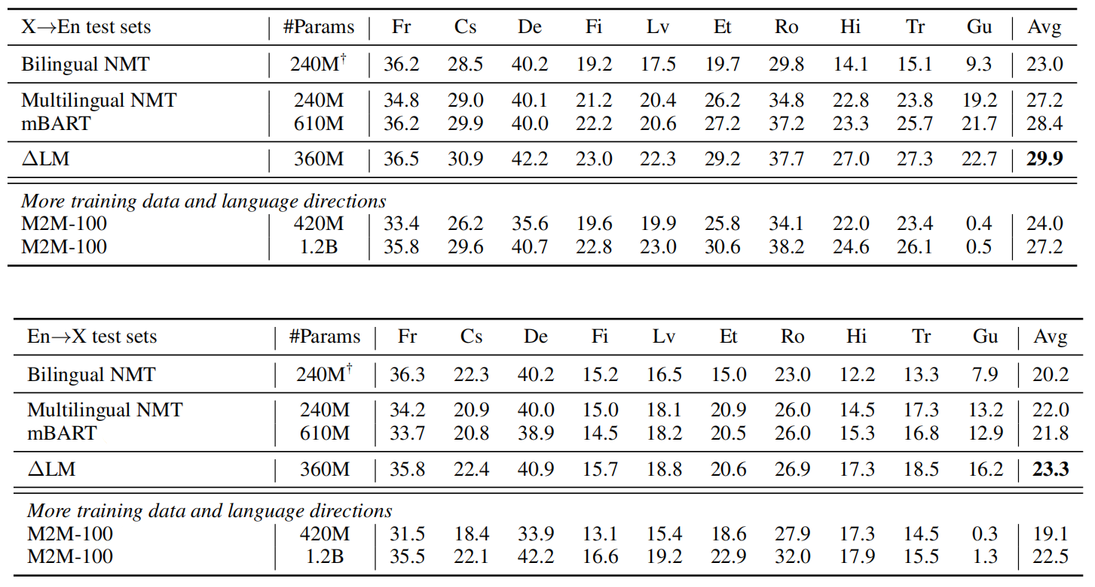
DeltaLM
Ma et al. 2021

Slide 31
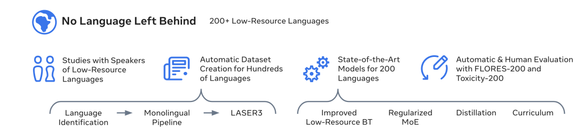
NLLB-200 : No Language Left Behind
MoEs
Dense
Distilled
XSTS
LID-200
Stopes library
Word-level
low-resource at later stages
Costa-jussà et al. 2022

Slide 32
NLLB-200: Recipe to Scale up to 200 languages
Mixture-of-Experts Model
Better sharing by routing low-resource through shared-weights.
Prevents overfitting on low-resource.
Curriculum learning
Train on high-resource first, then introduce low-resource, to prevent overfitting.
Self-supervised learning
Self-supervised learning on monolingual data for low-resource and linguistically similar high-resource languages for improved performance.
Diversified back-translation
Leverage BT data from various sources including Bilingual SMT models and existing MNMT models (BT data diversity).
Costa-jussà et al. 2022

Slide 33
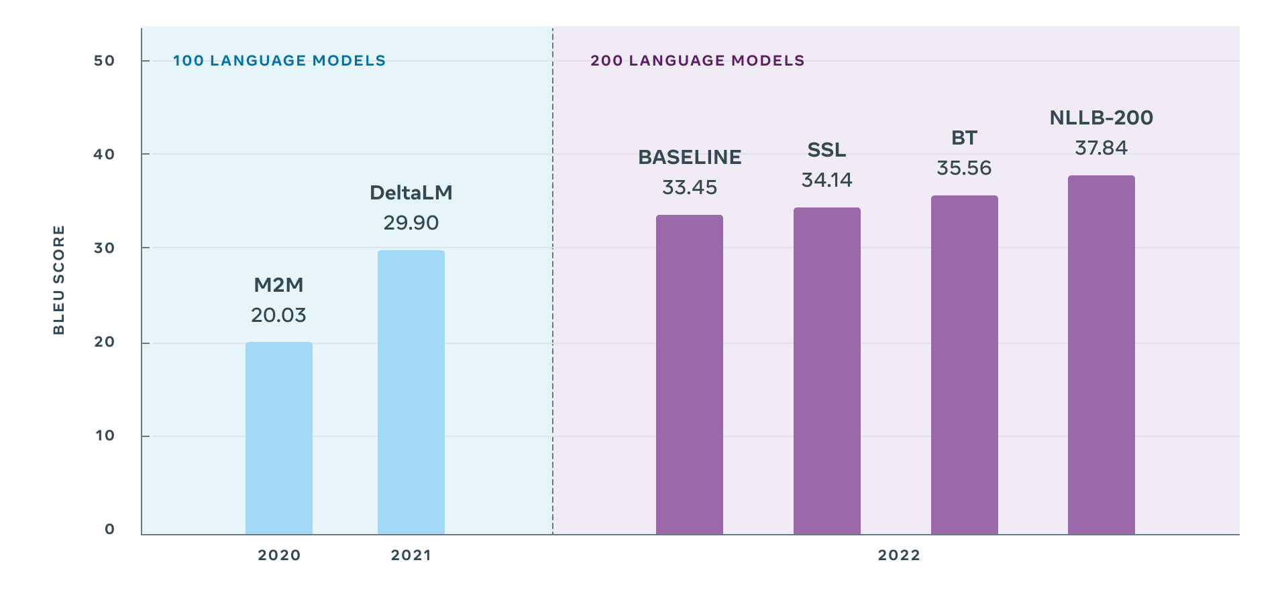
Average BLEU score on FLORES-101 (english-centric) M2M-100 and DeltaLM
Baseline on FLORES-200 (english-centric).
3.3B Transformer (base, with SSL, with BT) 54B MoE (SSL + BT)
Costa-jussà et al. 2022

Slide 34
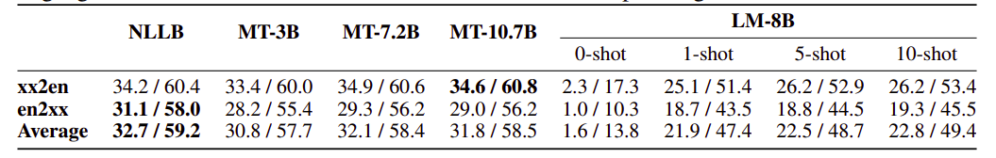
MADLAD-400
Rigorous filtering of monolingual data from CC across 419 languages.
Monolingual data -> 3T tokens.
Joint training (MASS + CE) -> 3 Enc-Dec variants (3B, 7.2B, 10.7B).
UL2 - 8B-Decoder-only (monolingual data).
Kudugunta et al. 2023

Slide 35
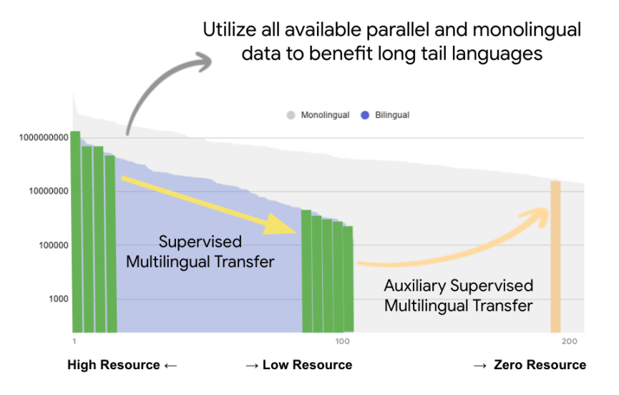
Towards the Next 1000 Languages in Multilingual MT
Scaling to 1000 languages by leveraging supervised and unsupervised objectives.
Leveraging all HRL monolingual and parallel data available to enable transfer to LRL.
Single stage joint training
denoising - MASS objective
translation - standard CE objective
Siddhant et al. 2022

Slide 36
Towards the Next 1000 Languages in Multilingual MT : Findings
High-quality data leads to significant performance improvements on related zero-resource pairs.
Num (Supervised Directions) > Num (Self-supervised / Zero-resource Directions) for maintaining performance.
Scaling parallel data is more important than scaling monolingual data.
Self-supervised pre-training leads to domain robustness in NMT.
Joint-pretraining + NMT better than 2-stage training (like BART).
Siddhant et al. 2022

Slide 37
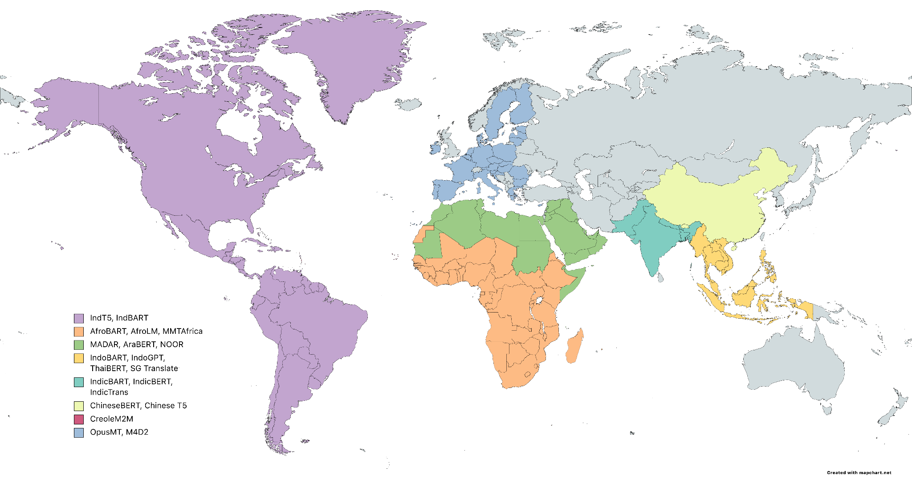
Models for related languages / Demography-specific Models

Slide 38
Main considerations to build SOTA models
Robust SOTA MT models
Data
Modeling
Benchmark
high-quality data
domain diversity
language relatedness
deeper architectures
training objectives
language relatedness
multi-domain
demography-specific
formality levels
Standard recipe for deep learning

Slide 39
Data: Parallel Corpus Creation

Slide 40
Monolingual data : Introduction & Need
Abundant on the Internet and in electronic format books
Primarily English and available in document-level format
Data from books not standardized, difficult to crawl and use
needs sophisticated extraction techniques
Regional language websites - Valuable sources for Low-resource languages
Collected using large-scale web-crawling efforts
example: C4 (English) and mC4 (multilingual)
Web data crucial for training language models and other purposes

Slide 41
How is monolingual data curated ?
URL Filtering
Language Identification
Line-wise Filtering
offensive, copyright content and spam filtering
script-based (unicode) model-based (fasttext, cld3, etc)
remove undesirable lines, repetitions, toxicity filters, etc
Text Extraction
Document-wise Filtering
Deduplication
tools for extraction include boilerpipe, warcio, trafilatura, etc
in-document repetition removal, toxicity filters, etc
fuzzy / exact substring deduplication
Data Preparation
Filtering
Deduplication
Penedo et al. 2033

Slide 42
Monolingual Data Curation Efforts
Large-scale
CommonCrawl (C4)
mC4
Pile
RedPajama
RefinedWeb
. . .
Language-group focused
IndicCorp (v1, v2), Varta (Indian)
IndoNLG (Indonesian)
IndCorpus (Indigenous)
WebCrawl African corpora (African)
CreoleMT/CreoleEval
. . .
Large-scale corpora with more general-purpose or one-fit-all heuristics, might yield noisy corpora for few languages at scale.
Fine-grained language-specific heuristics designed to ensure high quality corpora even though scales of data curated might be lower.

Slide 43
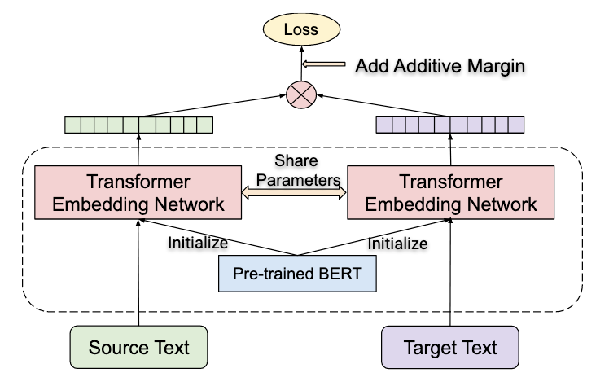
Sentence Embedding: LABSE
Supports 109+ languages
Dual-encoder approach for training
Stage 1: Continual pre-training on MLM + TLM
Stage 2: Translation-ranking + in-batch negative sampling
Additive margin softmax similar to SVM to discriminate good and bad translation pairs
One-for-all approach
Feng et al. 2020

Slide 44
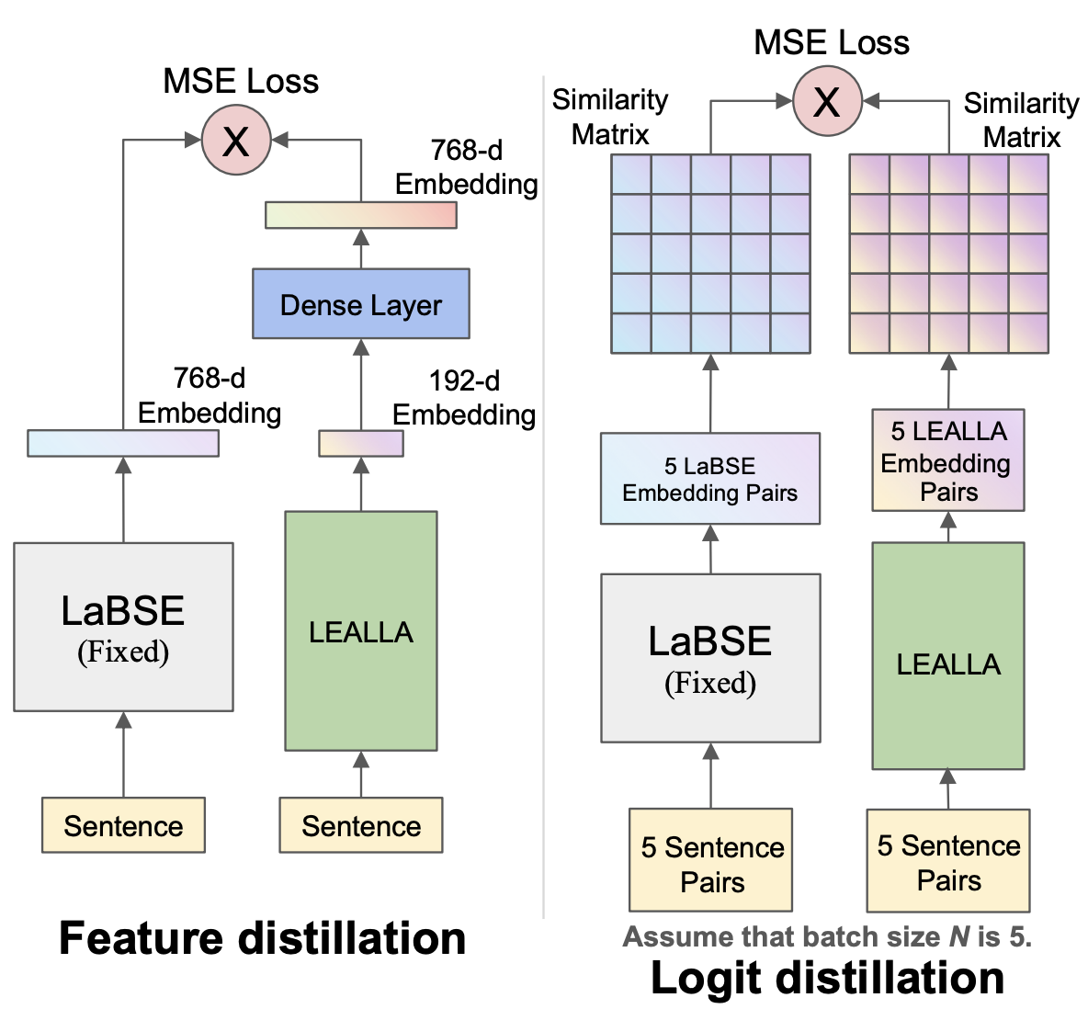
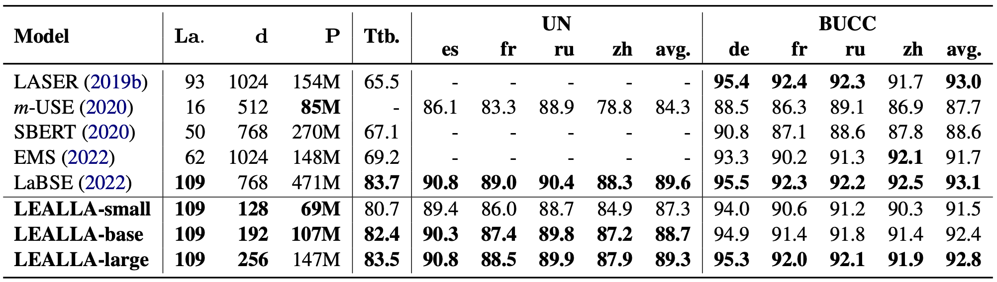
Sentence Embedding: LEALLA
A distilled LaBSE with increased inference efficiency and low-dimensional sentence embedding (128, 192 or 256)
Performs comparably with LaBSE for 109+ languages
Mao and Nakagawa, 2023

Slide 45
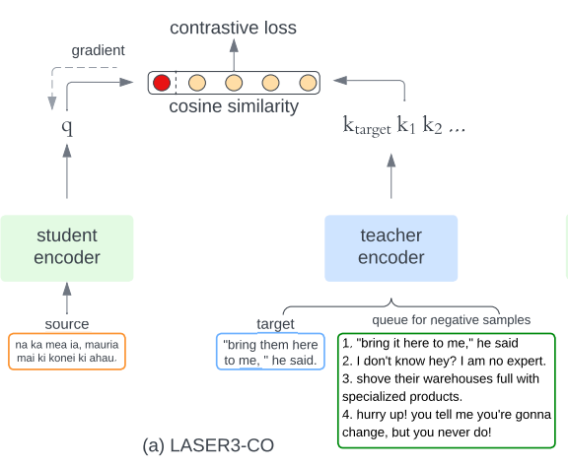
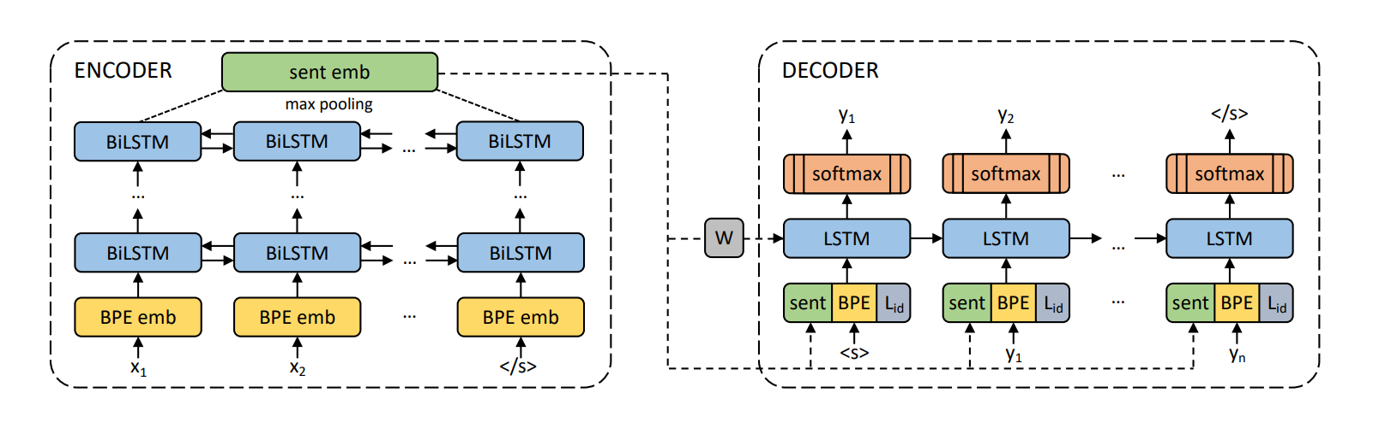
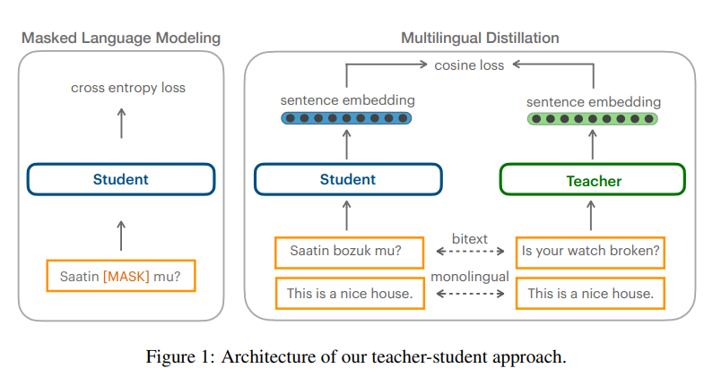
Sentence Embedding: LASERx
LASER1 Supports 93 languages
LASER - encoder of BiLSTM enc-dec NMT model
LASER2 - SPM instead of BPE + upsampling of low-resource
LASER3 - distilled LASER2 into language-specific encoders
LASER3 competitive with LABSE
Additional support for low-resource languages (147 encoders in total)
Schwenk et al. 2017, Artetxe et al. 2018, Heffernan et al. 2022, Tan et al. 2023
Notes:
LASER learns the multilingual sentence embeddings over 93 languages based on the NMT objective.
These sentence embeddings are used to initialize the decoder LSTM through a linear transformation, and are also concatenated to its input embeddings at every time step. Note that there is no other connection between the encoder and the decoder, as we want all relevant information of the input sequence to be captured by the sentence embedding
LASER2 replace the original LASER model with LASER2 by introducing SentencePiece vocabulary, up-sampling LRLs.
LASER3 : 147 language-specific sentence representation models are learned by utilizing teacher-student and MLM training mechanisms.
Why ? these models often suffer from insufficient capacity and interference between unrelated languages.

Slide 46
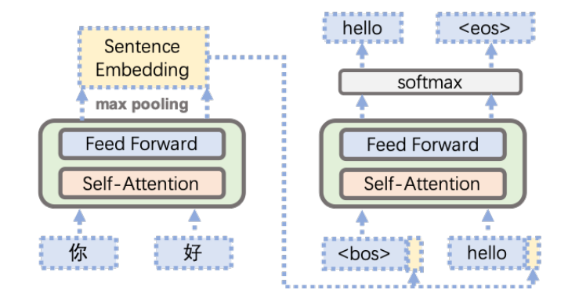
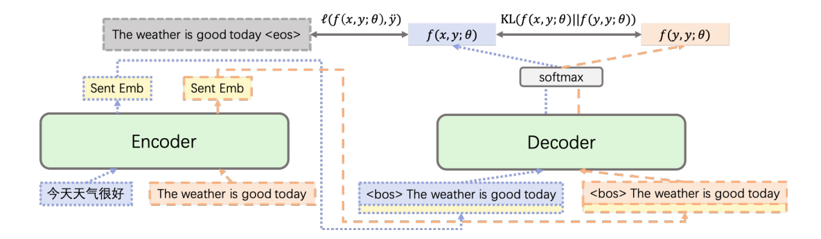
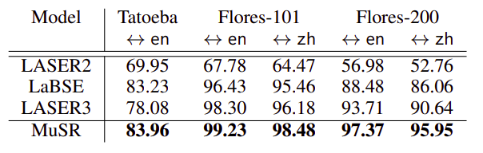
Sentence Embedding: MuSR
Gao et al. 2023
Notes:
Trained in a Many-to-English manner
Pretrain with NMT objective.

Slide 47
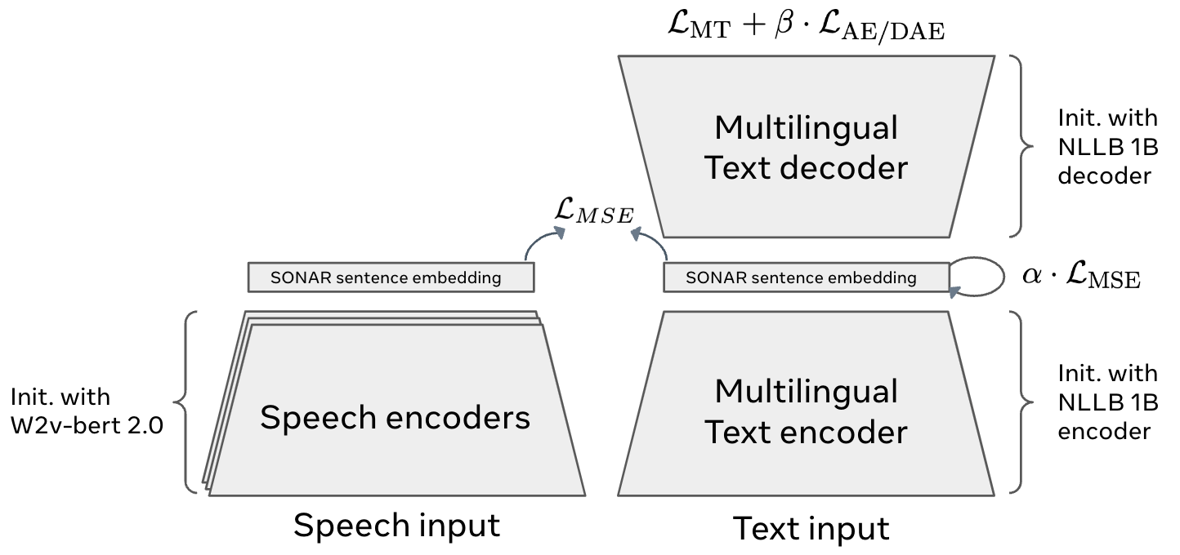
Sentence Embedding: SONAR
Supports 200 text languages and 37 speech.
Dual-encoder approach for training
Speech-text alignment
Text-text alignment
Duquenne et al. 2023
Notes:
Sentence-level multimOdal and laNguage-Agnostic Representations
random interpolation decoding

Slide 48
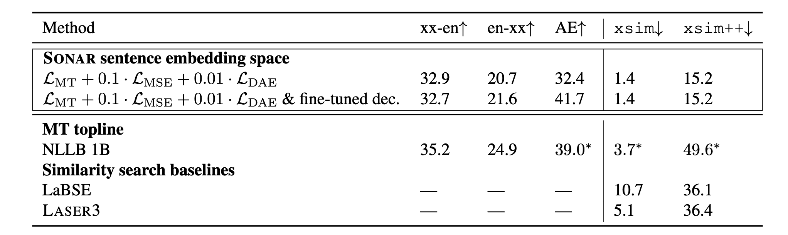
Sentence Embedding: SONAR
Duquenne et al. 2023

Slide 49

Mining parallel data at scale: Basics
https://news.un.org/sw/
Shared multilingual vector space*
LABSE / LASER3
https://news.un.org/en/

Slide 50

Issue : Infeasible at scale due to very large search space
___
___
___
___
___
___
En (429M)
___
___
___
___
Hi (473M)
FAISS Index for efficient indexing, clustering, semantic matching and retrieval of dense vectors.
(~1000 sent/sec).
Brute-force search (429M x 473M) is infeasible.
Johnson et al. 2019

Slide 51
CC-Matrix: Global Monolingual Mining
Global comparison of all unique sentences between source and target languages.
High computational cost, but eliminates the need for manual intervention or heuristics in identifying document-aligned data.
FAISS-index used for efficient indexing and retrieval.
Yields large-scale data, although compromising on quality due to global-level comparison.
Maximizes Recall, Precision might be compromised.
Schwenk et al. 2021

Slide 52
CC-Aligned: Comparable Corpora Mining
Heuristic-based document-level alignment identification. (human effort).
Sentence extraction from aligned documents.
Local search only on sentences between aligned documents.
Fast, scalable, more chance of mining high-quality bitext.
Lower computational requirements compared to CC-Matrix style global mining.
Rich resource for non-English pairs (same English document translated to multiple languages).
Emphasis more on precision.
El-Kishky et al. 2020

Slide 53
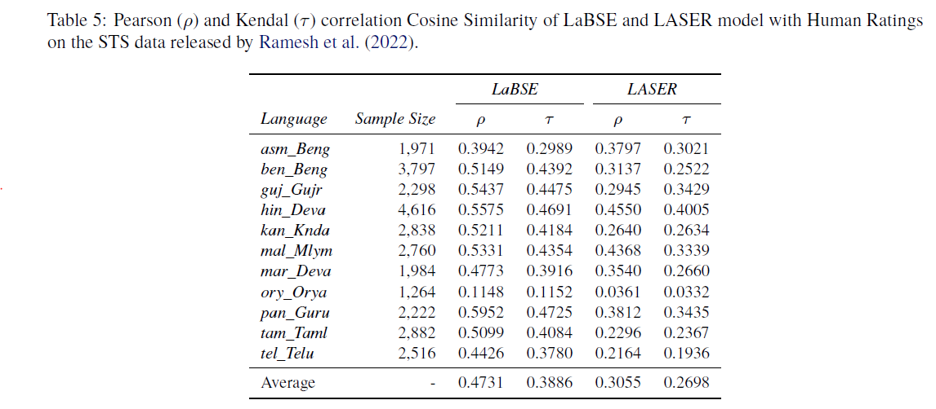
Choosing the appropriate sentence embedding model
Check correlation with human STS for the set of languages you wish to consider.
Gala et al. 2023

Slide 54
Parallel Corpus filtering
Q: Does noise affect model training ?
A: Depends.
If you operate at very large data and model scales.
⇒ Data at scale matters, noise has minimal impact.
[Gordon et al. 2021, Bansal et al. 2022]
If you are operating at lower data and model scales ?
=> It does. Eliminating noisy data improves NMT performance.
[Gala et al. 2023, Batheja et al. 2023]

Slide 55
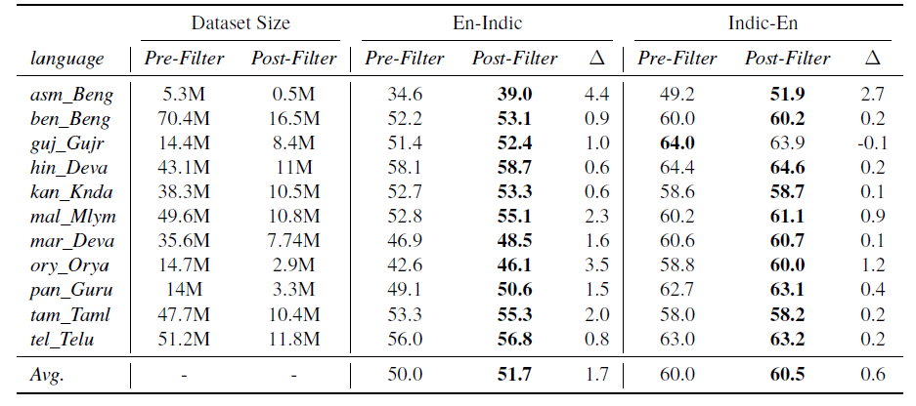
Data Quality v/s Scale Tradeoff
Data Quality matters over scale
Gala et al. 2023

Slide 56
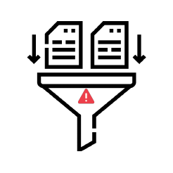
Parallel Corpus Filtering
Embedding Cos_sim thresholds
COMET
Referenceless
thresholds
0.80 threshold optimal for LABSE (Ramesh et al. 2022, Gala et al. 2023).
Embedding models might vary in performance with length.
Check COMET calibration for your desired language set.
Empirically determine language-specific QE thresholds. (No prior work).
Token count threshold heuristics might be useful to reduce false positives.

Slide 57
Seed Data: High-quality human-annotated data
Language-family-specific: ILCI (Jha et al. 2010) (Tourism).
Multilingual efforts:
NLLB-seed (Maillard et al. 2023) - multi-domain, inclusion of low-resource.
MASSIVE (FitzGerald et al. 2022) - spoken content.
BPCC-Human (Gala et al. 2023)
Enhanced domain coverage, emphasizing diverse domains and demographic representation to improve performance in India-centric use cases.
Inclusion of content not typically covered in web crawls, such as informal or spoken content, to make models more robust.

Slide 58
Benchmark

Slide 59
Benchmarks
Benchmarks are indicators of performance of systems on the task across different settings.
Benchmarks are harder to create, limited in quantity as well as demographic diversity, and also variable in quality.
NMT systems have reached a fair point, multi-domain demography-specific benchmarks important to drive further progress in terms of quality and suitability for production-usage.
Creation of benchmark for tasks like NMT is much harder than it seems.
Why?
So many systems out there, biases are bound to come in
QC Procedure ?

Slide 60



Existing benchmarks
WMT Shared Task Benchmarks
Direction-specific
Human-generated
Limited language coverage
Limited domain coverage (usually news).
FLORES-x
Largest coverage 200+ langs.
Multi-domain
Human-generated
Limited demographic coverage
Only prose or formal style of text.
NTREX-128
128 languages.
Human-generated
Limited demographic coverage
Only news (WMT).
Only prose or formal style of text.

Slide 61






Wishlist for creating a NMT benchmark
Multidomain
Diverse Sources
Demographic Coverage
Quality Controlled
Deduplicated with existing benchmarks
Formal + Informal

Slide 62
Benchmark Creation Procedure
Identifying Sources
Sampling sentences
Automatic QC
Multi-domain content from diverse sources of the said demographics.
Sample source sentences, keeping length and domain diversity in mind.
Automated plagiarism detection mechanism to avoid biases towards external NMT systems.
Sentence Verification
Translation
Review : Manual QC
Get content from the sources, conduct sentence verification and domain classification.
Get the sentences translated into the target language.
Human verification and correction to ensure high-quality.
Data Preparation
Translation
Quality Check

Slide 63
Deduplication with Benchmarks
Most benchmarks being created from Wikimedia entities / data on web.
Most data crawls include entire internet, so susceptible to leakages.
Apply strict deduplication technique with benchmarks, to ensure minimal data leakages and ensure robust evaluation.
Pre-hoc deduplication (Existing benchmarks) | Post-hoc deduplication (New benchmarks)
Eliminate data leakages from training / pre-training data to obtain an unbiased estimation of translation quality. | Only evaluate on those sentences from the benchmark which did not have overlaps in training data.

Slide 64
Evaluation Set Leakage Elimination Strategies for NMT Data
Parallel / Exact Dedup
Exact Monolingual Dedup
Fuzzy Monolingual Dedup
Strictness
Eliminate X,Y pairs from training data if present in benchmark
Only eliminates exact pair matches from benchmark.
Eliminate all pairs with monolingual side of sentences from benchmark.
Eliminates exact matches as well as paraphrases.
Eliminate all pairs with monolingual side of sentences from benchmark.
Here the matching is fuzzy, n-gram based and hence stricter.
Gopher and Megatron uses 13-gram fuzzy dedup

Slide 65
Modeling
Decision choices affecting massively multilingual MT

Slide 66
Core considerations
Vocabulary
Architecture
Training

Slide 67
Core considerations
Vocabulary
Architecture
Training

Slide 68
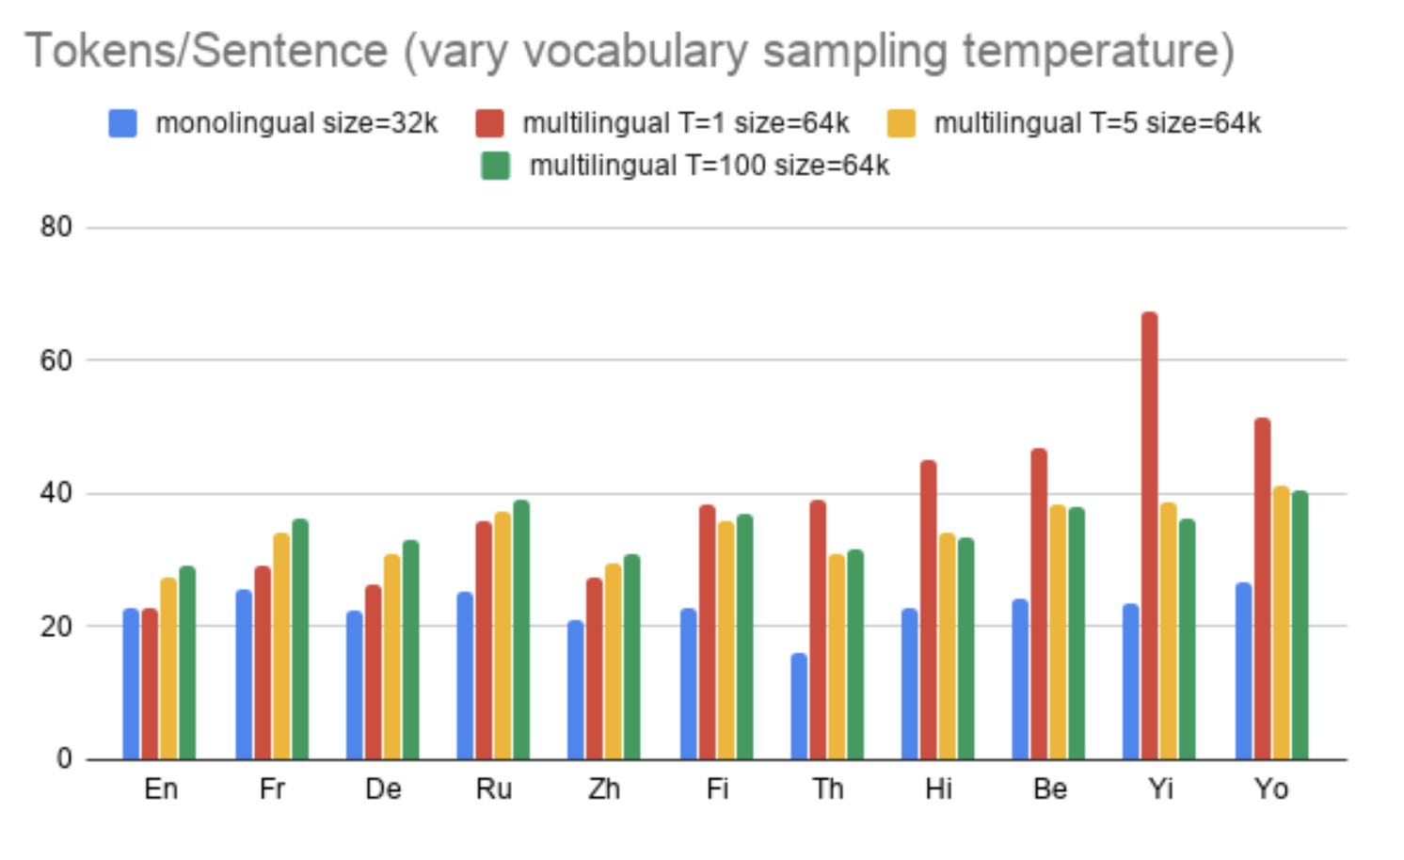
On Vocabulary
Goal: Fair representation across languages
Problem: Imbalance of data
Lower-resource languages get smaller share of vocab space
More character level representation
Higher fertilities
Longer sequences
Training time impacted
Downstream performance impacted
Arivazhagan et al. 2019
Notes:
Balancing vocabulary
Temperature sampling
Limit of skew (paper showing that even 10% vocab for language is enough)
Does vocabulary size matter

Slide 69
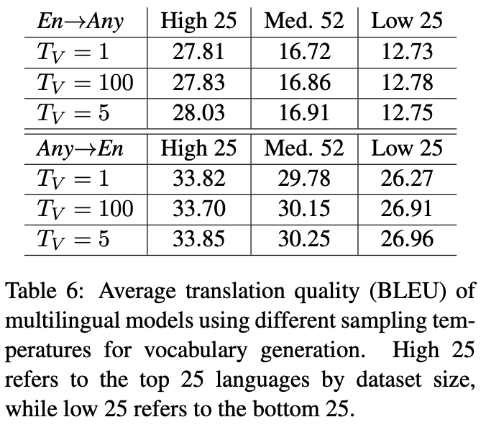
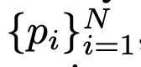
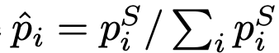
Solving The Vocabulary Skew
Same number of tokens per language
Wasteful since not enough training data anyway
Balance the distribution with temperature
Original distribution:
Modified distribution:
S = T⁻¹ where T is the temperature
T=1 for original distribution T=100 for equal distribution
Minor impact??
Arivazhagan et al. 2019

Slide 70
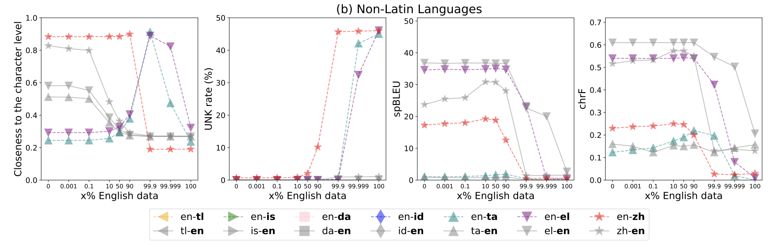
When does skew really hurt?
Study by Zhang et al. 2022
Just dont go to character level and have high unk rates
Training data balancing >> Vocab data balancing
Zhang et al. 2022

Slide 71
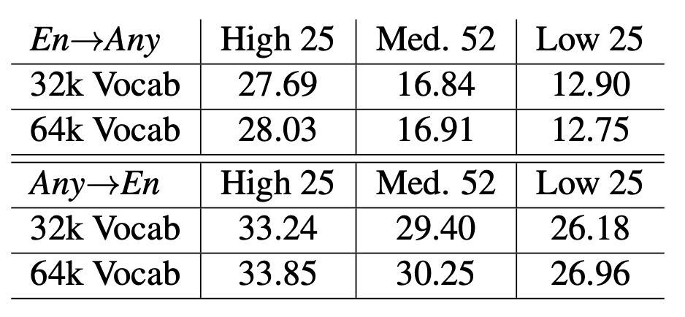
Does Vocabulary Size Matter?
Very little!
But dont push it :-)
Arivazhagan et al. 2019

Slide 72
Vocabulary For Related Languages
Shared scripts enable smaller vocabularies without going to character level
Opportunity to have compact models
Smaller softmaxes means faster training and decoding
Transliteration to boost cognates: Boost transfer
Into English - Universal Romanization (Hermjakob et al. 2018, Sennrich et al. 2016)
Into Kanji/Hanzi: Different languages - Similar scripts (Song et al. 2020)
Into a common related language - IndicBERT (Kakwani et al. 2021), IndicBART (Dabre et al. 2022), IndicTrans2 (Gala et al. 2023)
Boosting overlaps (NLU): Overlap BPE (Patil et al. 2022)

Slide 73
Vocabulary For Related Languages (2)
Special case: Creoles (Dabre et al. 2014 & 2022, Lent et al. 2022 & 2023)
Free ride due to high similarity with parent languages
Multiple segmentations as related languages
Kambhatla et al. 2022
Multiple segmentations of same sentences boost translation
Potato_, Po tat o_, Potat o_
BPE-dropout (Provlikov et al. 2020)
Subword regularization boosts low-resource performance

Slide 74
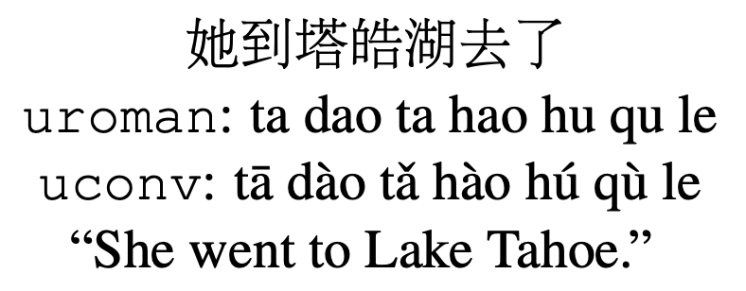
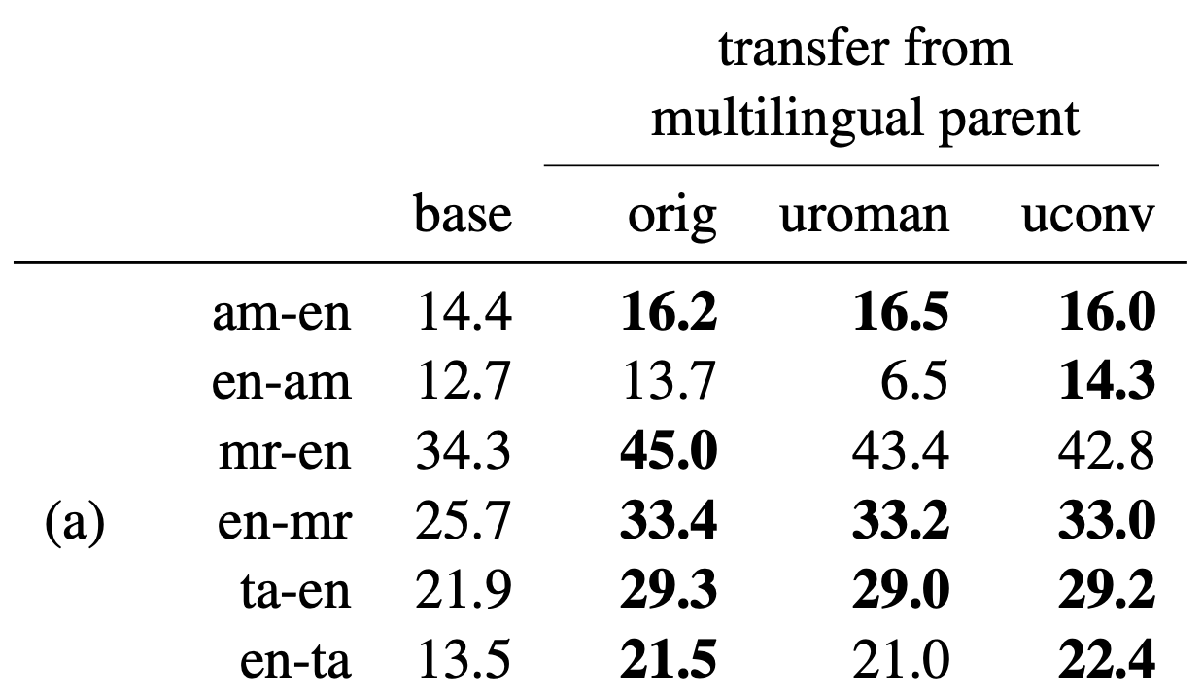
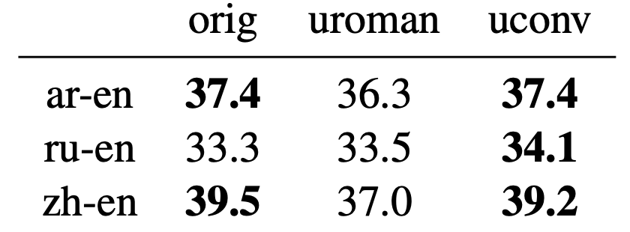
Universal Romanization
Hermjakob et al. 2018

Slide 75
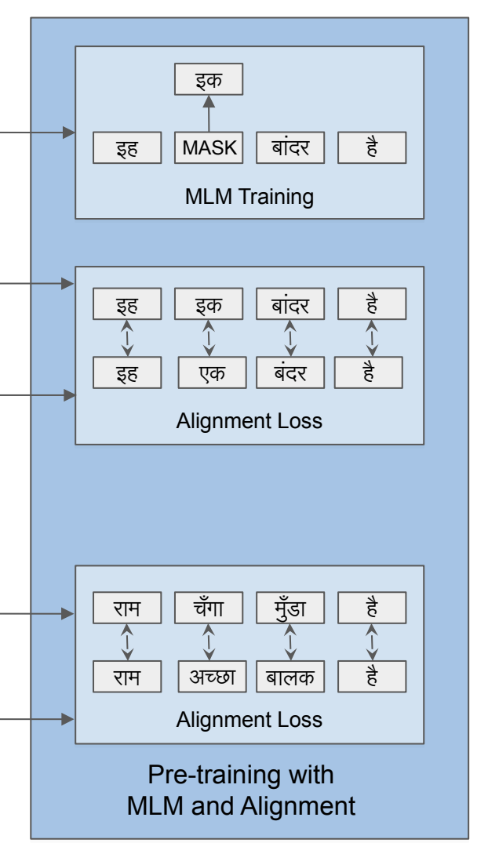
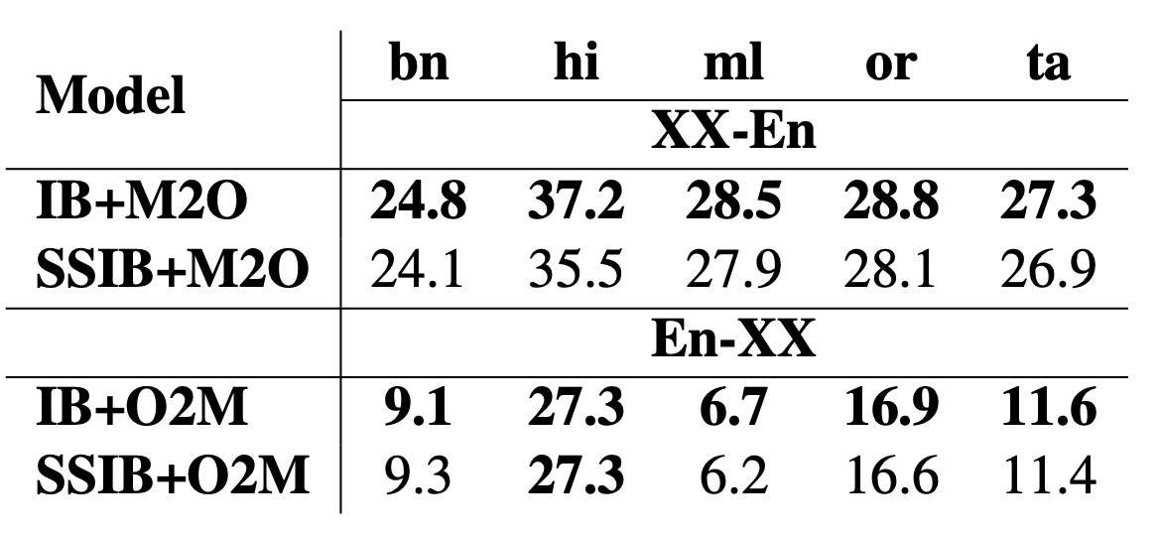

Family Specific Transliteration
Hindi to Tamil (Indic NLP Library)
input_text = राजस्थान (rajasthan)
output_text = ராஜஸ்தாந
Typical solution: Map to the highest resource or related language
IndicBART (Dabre et al. 2022)
IndicTrans2 (Gala et al. 2023)
RelateLM (Khemchandani et al. 2021)
Xlingual noising
Khatari et al. 2021
Other solutions: Subgroup?
Indo-Aryan vs Dravidian
Kunchukuttan et al. 2017 Goyal et al.2020

Slide 76

Zero-Shot Translation Capabilities of IndicTrans2
tl;dr. Zero-shot (into-English) performance of IndicTrans2 close to NLLB-54B (N54) (explicitly tuned for those languages).
Potential for light-weight and rapid adaptation to extremely low-resource languages. (Neubig et al. 2018)
Gala et al. 2023

Slide 77


Artificial Noise: Induce Vocabulary And Zero Shot Translation
Bhojpuri, Chattisgari
Extremely low-resource
Very similar to Hindi
Many spelling variations
Noise
Character span noise
Unigram noise
Improved zero shot translation
Up to 6 BLEU gains
Linguistic noise ineffective
Scope for investigation
Aepli+, 2022, Maurya+, 2023

Slide 78

Orthogonal: Leveraging Ordering Information
Reorder parent-source sentence to match child-source sentence
Ensures better alignment of encoder contextual embeddings
Significant improvements over baseline finetuning: needs a parser and re-ordering system
Popovic et al. 2016, Mao et al., 2020, Jones et al. 2021, and Mao et al., 2022 also focus on syntactic differences
Puduppully et al. 2023 show that monotone word order helps related language MT
Philippy et al. 2023 highlight more considerations for crosslingual transfer (survey)
Murthy et al., 2019

Slide 79
Summary: Make friends, not enemies!
(Force?) Share vocabulary
Ensure balance
Noise is your friend
Reorder
Leverage dictionaries
Size impacts minimally

Slide 80
Core considerations
Vocabulary
Architecture
Training

Slide 81

Architecture Variants
NLU
NLU
NLU
NLG
NLG
image credits

Slide 82
Architecture Variants: Block Choices
Dense
Most commonly used
Standard transformers
Sparse
Recent interest
Mixtures-of-experts
Hybrid
Partially explored (M2M)
Extra hyperparameter

Slide 83


(Sparsely Gated) Mixtures Of Experts
1 FFN becomes N FFNs
Insert every K^{th} layer
Route to 1 or more
Load balancing important
Lephkin et al. 2020
Explosively increase params
Difficult to train
ST-MOE to the rescue
Zoph et al. 2022

Slide 84

MoEs Automatically Learn Clusterings
Chen et al. 2022. Each color means different expert. Experts work together.
Chen et al. 2022

Slide 85


Routing Decisions Lead To Language Clusters
Costa-jussà et al. 2022 analyze gating vectors (NLLB)
Plot of cosine similarity between language level gating vectors
Language families have similar gating behavior
Kudugunta et al. 2021 manually route tasks or languages to experts
Suitable for related languages
MoLEs by Gu et al. 2018

Slide 86


Boosting Zero Shot Translation
Reasons for overfitting to seen patterns (negatively affecting ZS)
Universal positional encodings
Residuals
Skip residuals
Different position encodings as queries
Different frequency from input ones
Liu et al. 2021

Slide 87

Note On LLM Only MT Modeling
Zhang et al. 2022

Slide 88

Decoder Only MT Performance
Depth > Width at smaller scales! Encoder-Decoder is still the best at scale!

Slide 89

But!
Better zero-shot performance of prefix-LMs is intriguing!
(Cool implications for related languages)

Slide 90
Summary: Wise Choices Maketh a Model!
Use MoEs for Scale
Design language group specific modules
Dense models are not ideal
Careful about PEs and Normalization
LMs are decent MT models for zero shot

Slide 91
Core considerations
Vocabulary
Architecture
Training

Slide 92
All At Once (Joint) or Stage-wise (Incremental)?
All Corpora
Model
Train
Corpora Subset A
Model A
Corpora Subset B
Model B
Corpora Subset B
Modification
Modification
Train Stage 1
Train Stage 2
Train Stage 3
....

Slide 93
Joint Training: All At Once!

Slide 94
Training Schedule: Joint Training
One pair at a time (Firat et al. 2016, Dong et al. 2015)
Cycle through corpora (L₁-L₂ →L₃-L₄→L₅-L₆→.....→L₁-L₂)
Useful for models with separate encoders and/or decoders
Potential forgetting of language pair information in a previous batch
Catastrophic forgetting!

Slide 95
Training Schedule: Joint Training
Mixed language pairs batch (Johnson et al. 2017)
Mix all corpora, shuffle and then choose batches
Useful for fully shared models
For models with separate language encoders/decoders
Shard batch and feed to appropriate components
Special encoders for language families

Slide 96
Are Language Family Specific Models Better?

Slide 97
Yes They Are!
Child Language | Parent Language |  |  | Multilingual Δ(FS - FA )
 | Turkish (135M) | Arabic (134M) | Hindi (60M)
Hausa (1.6M) | -0.05 | +0.85 | +0.01 | +0.66
Uzbek (8M) | +1.33 | +0.79 | +1.1 | +2.79
Marathi (7.3M) | +1.64 | +1.35 | +1.87 | +2.88
Malayalam (4M) | +2.27 | +1.53 | +2.27 | +0.44
Punjabi (5.7M) | +1.15 | +0.34 | +1.88 | +3.75
Somali (3.5M) | +2.28 | +2.68 | +2.55 | +0.96
From my Ph.D. thesis (2018)
Goyal et al. 2020
Jointly training HRL and LRL
Similar HRL and LRL is best
Training joint multilingual models
FS = Family Specific
FA = Family Agnostic
Family specific models are better

Slide 98

Visualization Of MNMT Representations
SVCCA similarity between representations (Kuduganta et al. 2019)
Also see Dabre et al. 2017 and Johnson et al. 2017
Encoder representations cluster sentences into language families
Regardless of script sharing
Script sharing for stronger clustering
High resource languages cause partition
Low-resource languages ride the wave
Evidence of representation invariance when fine-tuning
Explains poor zero shot quality between distant pairs

Slide 99



Empirically Determined Language Families
Train many-to-many model with language tokens
Hierarchical clustering of tokens
Set number of clusters by elbow-sampling
Tan et al. 2019
Also see Oncevay et al. 2020
LangRank: find similar languages (Zhou et al. 2021)
Predetermined language families
Empirically determined language families via embedding clustering

Slide 100


Is There An Optimal Number of Languages
Does empirical clustering help? (Upper table)
Mostly yes
Random clustering gives poorer results
Predetermined clustering is equally good
Language family specific models (Bottom table)
Universal model < Individual models
Family specific model > Individual models
Related to observations by Dabre et al. 2018
Next steps
Family specific adapter layers (Bapna et al. 2019)
Family specific vocabulary and decoder separation
Behavior in extremely low-resource settings (<20k pairs; Dabre et al, 2019)

Slide 101


Leveraging Noise and Paraphrasing For Related Languages (Aly+ 2021)

Slide 102



Joint Denoising and Adversarial Approaches For Alignment
Forcing representations of related languages to be similar helps!
Ko et al. 2021

Slide 103
Training Schedule: Addressing Language Equality
Source of inequality: Corpora size skew
Solutions: Oversampling smaller corpora
Oversampling before training or during training?
Matter of implementation choice
Oversampling prior to training creates large duplicated corpora

Slide 104


Importance Of Temperature Based Sampling
Naive approaches:
Ignore corpora size distributions
Sample from all corpora equally
New approach: Temperature based sampling (p_{L}^{(1/i)} )
Where p_{L} is the probability of sampling a sentence from a corpus
i is the sampling temperature
Strongly benefits low-resource pairs
Arivazhagan et al. 2019

Slide 105
Stage-wise Training: A Bit at a Time!

Slide 106
Why Stage-wise/Incremental Training?
All at once cant be learned effectively
Missing languages
Data skew
Difficulty in handling language group phenomena explicitly
Benefits
Incorporating new languages
Expanding capacity
New tokens
New layers
Adapters

Slide 107
Pre-training on Related Languages
Language | Parent Language
 | French (2B) | German (1.7B) | Hindi (60M) | Russian (0.53B)
Hausa (1.6M) | +2.85 | +2.17 | +2.03 | +2.99
Uzbek (8M) | +0.12 | +0.22 | +0.46 | +0.34
Marathi (7.3M) | -1.62 | -0.38 | +0.57 | -0.55
Malayalam (4M) | +1.31 | +1.89 | +2.8 | +1.45
Punjabi (5.7M) | +0.8 | +0.67 | +2.41 | +0.69
Somali (3.5M) | +3.17 | +2.69 | +2.26 | +2.89
Language | Parent Language
 | German (1.7B) | Hindi (60M) | Turkish (135M) | Indonesian (129M)
Kazakh (16M) | +0.21 | +0.4 | +0.48 | -
Javanese (9.7M) | +1.1 | +0.44 | - | +2.47
Sundanese (17.7M) | -0.13 | +0.41 | - | +1.1
Luxembourgish (5.13M) | +8.58 | +6.44 | +6.01 | -
Dabre et al. 2017
HRL is parent
LRL is child
Best transfer across related languages
Up to 8.6 BLEU gains
HRLs can also benefit
Nguyen et al. 2017
Neubig et al. 2018

Slide 108

Incorporating New Languages
Language specific transfer
Replace vocabulary
Fine-tune on new data
Similar to Zoph et al. 2016
Expanding to new languages
Expand vocabulary
Fine-tune on old+new data
Increase computational capacity?
WECHSEL for initialization
Surafel et al. 2018

Slide 109


Capacity Expansion Of Existing Models
Add new components while freezing existing components
Lightweight training BUT
Previous components may not be aware of new languages
Poor transfer learning
Potential zero-shot learning
Will it work for distant languages
Similar recipe for multimodality (Duquenne et al. 2022)
Lessons from Sachan et al. 2018; Firat et al. 2016a/b; Bapna et al. 2019
Deepen encoders and decoders
Only train new components with old and/or new data
Vocabulary expansion by Surafel et al. 2018 will help
Escolano et al. 2019

Slide 110


Adapting Previously Trained Models
Feed forward layers to refine outputs
Bapna et al. 2019
Partial solution to bottleneck
Language pair specific
Zero-shot performance?
13.5% larger models
Improved high-resource pair performance
Low-resource performance kept

Slide 111


Adapters For Related Languages
Language family specific adapters
Gumma et al. 2023
Chronopoulou et al. 2023
Mixtures of adapters
Wang et al. 2023
Automatic adapter clustering
Language branches (Sun et al. 2022)
Adapter ensembling
Use similar languages
Wang et al. 2021
Hyperadapters (Baziotis et al. 2022)
Base parameters to create specific adapter instances
Contextual parameters (Platanois et al. 2018)
Similar languages support each other
Networks encode relatedness

Slide 112


Family Specific Adapters
Definite advantage over language agnosticism
Strong gains for distant languages
Balto-slavic are more similar to English
Gains regardless of supervised or unsupervised directions!
Chronopoulou et al. 2022

Slide 113

Vocabulary Expansion Not Needed For Related Languages
Creoles and dialects can be well segmented by related language tokenizers
Selected tokenizer impacts performance (choose wisely!)
Chen et al. 2023 (mBART50 for South American indigenous languages [Spanish based])
Dabre et al. 2022 (mBART50 for Mauritian Creole [French Creole])

Slide 114
Multi-stage training (Curriculum?)
Train the model on the BPCC
(Stage 1)
Experiment well with forward as well as back translations!
Train the model on the BPCC + BPCC-BT
(Stage 1)
Data Augmentation using back translation: BPCC-BT
(~400M bitext pairs)
Fine-tune the model on the seed corpora
(Stage 2)
Fine-tune the model on the seed corpora
(Stage 2)
Auxiliary
Downstream
Train the Model from scratch
Finetune the model from stage 1

Slide 115

Importance of Tuning on Clean Corpora
En-Indic did better with forward translated data! (Relatively smaller monolingual corpora to blame?)
Gala et al. 2023

Slide 116


Importance of Curricula
Dabre et al. 2019: Introduce low-resource later
Jointly training HRLs and LRLs was suboptimal
Best recipe: HRL --> HRL+LRL --> LRL
Noisy --> Noisy+Clean --> Clean
Add complexity then reduce!
Mohiuddin et al. 2022: Score and select subsets
Start with General Domain model
Score instances:
Use external scorer
Use model itself
Related to: Wang et al. 2017
Faster convergence
Better performance
Low resource languages:
Scoring using related HRL?

Slide 117
Summary: Wise Choices Maketh a Good Model!
Freeze for efficiency and not forgetting
Build incrementally, in stages, with curricula
Add vocabulary as applicable
Group specific models and adapters are promising
Careful about balance of languages
Leverage noise, paraphrases, adversaries wisely

Slide 118
Model Compression: Light as a Feather!

Slide 119

Why Compression?
I am a boy
私は男の子です
Behavior | #Params | Translation Quality | Translation Speed
Default | Many | High | Slow
 | Few | Low | Fast
Desired | Few | High | Fast
Achieved using sequence distillation Kim and Rush, 2016
Kim and Rush, 2016

Slide 120

Compression Approach: Pruning
Structured Pruning: Remove specific layers or groups
Unstructured Pruning: Remove least important weights or neurons
Han et al. 2015

Slide 121

Memory-efficient NLLB-200
Determine statistics: Expert importance and routing probabilities
Prune: Per layer or Globally
Koishekenov+ 2022

Slide 122


Quantization
Dettmers et al. 2022, Dettmers et al. 2022
7B params = 28 GB in FP32
= 3.5 GB in FP4 Go low!

Slide 123




Distillation
Word level distillation (online)
Use parent distributions
Not always good
Sequence level distillation (offline)
Translate to get parents token distributions
Mostly enough
Interpolation (hybrid)
Use both losses
Kim and Rush, 2016

Slide 124



Distillation For Related MT Model
Final tuning on clean data is important even in distillation!
Gumma et al. 2023, Gala et al. 2023

Slide 125

Distilling Large Models
Wiki Corpus
Train Large Model
NLLB 54B MoE
Adapt for Domain (optional)
NLLB 54B MoE
Wiki
Offline sequence distillation is too expensive for large models!
NLLB Corpus
Word Level Distillation (online)
1.3B Dense
600M Dense
Costa-jussà et al. 2022

Slide 126
Leveraging Bilingual Models
Training from scratch is challenging
Multitude of pairs
Complexity of task
Interference of languages
Solution: Leverage bilingual models or smaller multilingual models
Key principle: Transfer learning via sequence knowledge distillation (Kim et al. 2016)
Train wide and/or deep model
Big NMT model
L₁→L₂
Decode L₁
L₁→L’₂
Distillation data
Train narrow and/or shallow model
Small NMT model

Slide 127
Distillation For MNMT Training
L₁→L₂
model
L₁→L₂
Decode L₁
L₁→L’₂
Smoothed labels
Train MNMT Model With Smoothed Data and Labels
L₃→L₄
model
MNMT
model
L₃→L₄
Decode L₃
L₃→L’₄
.
.
.
Smoothed labels
L_{m}→L_{n}
model
L_{m}→L_{n}
Decode L_{m}
L_{m}→L’_{n}
Smoothed labels
Tan et al. 2019

Slide 128
Summary: The Holy Trinity
Prune and Tune
Distill
(online?)
Quantize

Slide 129
Implementations and Toolkits

Slide 130
Toolkits: The Big 4
Fairseq (v1/v2) by Meta
Pytorch
Comprehensive for MT pre-training and fine-tuning
All rounded and most popular among researchers
Transformers by HuggingFace
Pytorch/Tensorflow
Most popular for fine-tuners
Has a hub for all models
Tensor2tensor by google
Tensorflow
Deprecated in favor of TRAX
OpenNMT by various researchers
One of the earliest
Both pytorch and tensorflow
Large code bases. Overwhelming for beginners!

Slide 131
More Toolkits
MarianMT by several researchers
Written in C++ and minimal dependencies
JoeyNMT by Amsterdam and Heidlberg universities
Minimal
For beginners and learners
Sockeye by Amazon
Pytorch
Distributed training and efficient inference
YANMTT by NICT (actually mainly ME)
Pytorch
Distributed multilingual pre-training and fine-tuning (of lightweight models) at scale
Started out as a pre-training script
My hobby/pet project :-)

Slide 132
On Evaluation
We built a model but how good is it?

Slide 133

Taxonomy of MT Metrics
Lee et al. 2023, Sai et al. 2020

Slide 134

Which String-based Metric Is Reliable These Days?
chrF/chrF++ most reliable.
Do significance testing.
Especially for Indic languages.
End of BLEU?
Sai et al. 2023

Slide 135


COMET
Rei et al. 2020 Freitag et al. 2021
Source
Direct Assessment
(1 score)
COMET DA
Translation
Reference (optional)
MQM
(Annotations)
COMET MQM
Annotations to score via formula

Slide 136

IndicComet
Comet DA
Indic Comet DA
Indic DA
Fine-tune
Indic MQM
Comet MQM
Indic Comet MQM
Improved human correlations!
Excellent zero-shot capability. Influence of related languages?
Sai et al. 2023

Slide 137

Limitations of Learned Metrics
Amrhein et al. 2022: COMET makes mistakes
Not sensitive to number and named entities discrepancies
Hard to fix biases via fine-tuning
Moghe et al. 2023: Poor quality estimation - downstream performance correlation
Metrics have negligible correlations with the extrinsic evaluation of downstream outcomes
Scores provided by neural metrics are not interpretable
Diverse references and metrics to produce labels instead of scores (MQM?)

Slide 138

LLMs For Evaluation (GEMBA)
Large PALM models prompted for MQM gave better correlation with human annotations!
Kocmi et al. 2023, Fernandes et al. 2023

Slide 139
Evaluation Implementations
String-based
SacreBLEU (Post et al. 2018)
Model-based
COMET (Rei et al. 2020, Freitag et al. 2021)
BLEURT (Sellam et al. 2020, Pu et al. 2021)
IndicCOMET2 - WIP
always perform significance testing

Slide 140
Human Evaluation: For Humans By Humans!

Slide 141
Human Evaluation
Adequacy :- Faithfulness of the translation to its source.
Errors like omission, unwarranted additions / mistranslations.
Needs bilingual evaluators
Fluency :- How fluent is the translation as a standalone sentence in the target language.
Factors include naturalness, grammatical / spelling errors.
Can be conducted by monolingual evaluators
Most critical aspect of Human evaluation : Inter-Annotator-Agreement
Humans can be subjective, sometimes too strict or too lenient, we want consistency.

Slide 142
Human Evaluation : Relative Ranking
Annotators shown outputs of 2 or more systems and have to rank the systems.
Relative measure.
Not an indicator of how-good or how-bad a system is.
Usually poor Inter-Annotator-Agreement (IAA) observed for relative ranking.
Lacks interpretability and offers limited insights about aspects to improve upon (Adequacy / Fluency).

Slide 143
Direct Assessment
Absolute 0–100 rating.
DA-Adequacy
Annotators rate how adequately the candidate expresses the meaning of the corresponding reference translation on a scale of 0-100.
DA fluency
Annotators rate on a scale of 0-100 about how much they agree that a given translation is fluent target language text.
Reference-free evaluation.
Graham et al, (2013, 2014); Bojar et al. 2016

Slide 144

Relative Ranking v/s Direct Assessment
Input text
MT System
Output text
Human evaluators
Aggregation Strategies ?
System 1
👎
∑
System 2
👍
Averaging /
Max-voting.
Relative Ranking
2 ❌
3 ✅
System 2
∑
Direct Assessment

Slide 145

Multidimensional Quality Metrics - MQM
Lommel et al. 2014; Freitag et al. 2021

Slide 146

Example of a MQM annotation
Annotators assign scores based on the quality of translation and identified errors.
MQM provides more informed judgements
Sai et al. 2023

Slide 147

Semantic Textual Similarity - STS
More focus on Adequacy than Fluency !
Why ?
Fluency is subjective.
Modern use-cases like social media lack fluency by design.
Agirre et al. 2016

Slide 148
Cross-lingual STS - XSTS
Large degree of variance in STS ratings across different language pairs as pool of annotators and outputs are different.
Solution ? Calibration!
Annotators perform the task on actual data + calibration set (English output + Reference) for cross-lingual consistency, as evaluation is english-centric.
Compute average scores per annotator for calibration set.
Check annotator-wise deviations on the calibration set and apply this correction factor on the actual data as well to normalize it and impose some cross-lingual consistency.
Licht et al. 2022

Slide 149
How does GPT perform on IndicMT or LRL in general ?
IndicTrans2 GPT3.5 comparison conducted by us.
https://arxiv.org/abs/2309.07423
Gala et al. 2023

Slide 150
The future
Deepening the niche

Slide 151
What still lacks ?
Low-resource performance can still be improved.
Still many extremely low-resource languages
Still many relatedness ideas to explore and exploit
Idiomatic usage needs to be covered.
Non-english numerals expressed in words might result in hallucinations.
Many specific cases
Coverage of dialects and more languages
Extension to speech-translation
Speech to speech is the dream
Improve LLMs for MT
Will Decoders replace Encoder-Decoders? (I think not)
Document-level translation underexplored
Improve long context handling

Slide 152
Bringing in dialects
Dialects in India
Dialects of Marathi (42 dialects)
I speak only 3! :-(
Dialects in Japan
I can handle Osaka and Kyoto dialect but theres MORE!
Dialects is what people use but mostly spoken
Spoken language data collection needs focus
Creoles are mostly spoken
Case for direct speech-speech MT?
Let us collect data aggressively!
Language resource papers should not be looked down upon!

Slide 153
Summary
Big Picture
The current state MT
Data Creation
Manual and mining
Modeling
Models at scale
Compactness
Evaluation
Automatic
Human

Slide 154
Q&A
Thank You

